Slide 1

DriverPass System Analysis
Rex Waymire
Notes:
[No speaker notes required for this slide.]

Slide 2

System Requirements
The system shall allow students to schedule and cancel driving lesson appointments, and shall allow secretaries to schedule, change, or cancel appointments on behalf of students while handling scheduling conflicts.
The system shall allow students to take practice tests, grade those tests automatically, and display the results to the student.
The system shall allow instructors to take notes on students, and allow students to read notes written about them.
Notes:
For the DriverPass system, we identified several key requirements that the system needs to meet; functional requirements and nonfunctional requirements. These two categories describe what the system does and how well the system does it. From the functional requirements we decided to focus on three things. First, students need to be able to schedule and cancel their own driving lessons, and secretaries need to be able to do the same thing on a student's behalf. The system will also handle scheduling conflicts so that two students are never booked with the same instructor at the same time. This was a priority because scheduling is central to how DriverPass operates day to day. Second, students need to be able to take practice tests directly in the system. The system will grade those tests automatically and show the student their results right away. This supports DriverPass's main goal of helping students pass the DMV test by giving them a place to practice and track how they are doing. Third, instructors need to be able to leave notes on the students they work with, and students need to be able to read those notes. This keeps everyone on the same page about a student's progress and areas that need improvement.
When it comes to nonfunctional requirements: the DriverPass system needs to be accessible from anywhere on any system that the customer chooses to use, whether that is a desktop computer or a phone. It also needs to be fast and respond fast, no matter how many people are using DriverPass. Security is also a huge part of Driverpass. All the data will be encrypted, and passwords must be strong and strict. Every action that happens within the system of DriverPass will be logged, so that we can keep track of what everyone does in DriverPass, and if anything is changed. This makes DriverPass much more secure and able to be rolled back if anything unsecure happens.

Slide 3
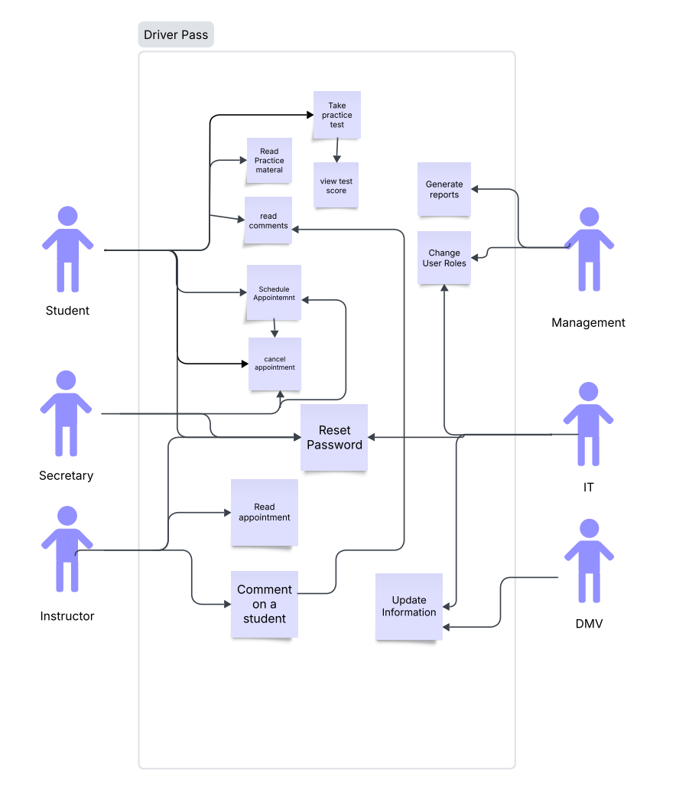
Use Case Diagram
Notes:
This diagram shows who will be using DriverPass and what each person can do within it. There are six different types of users represented here: the Student, the Instructor, the Secretary, Management, IT, and the DMV. The Student is at the center of DriverPass. Students can schedule and cancel their own driving appointments, read study materials, take practice tests, view their test scores, read notes that their instructor has left about them, and reset their password if they get locked out. The Instructor can view their own schedule to see which students they are working with, leave notes on a student after a lesson, and reset their password. The Secretary supports the day-to-day operations by scheduling, changing, or canceling appointments on behalf of students. The secretary can also help students who are having trouble with their account by assisting with password resets. Management has access to the bigger picture. They can generate and export reports on things like student attendance, instructor schedules, and other business data. They can also manage user accounts, change user roles, and reset passwords. IT keeps the system running. They can update the system and its databases, roll the system back if something goes wrong, read activity logs to troubleshoot issues, change user roles, and reset passwords. IT also receives emergency notifications if DriverPass has a problem. The DMV is not a person who logs in, but it is still an important part of the diagram. DriverPass pulls updated rules and regulations from the DMV so that the study materials and practice tests always reflect what students will be tested on at the DMV. Every part of this diagram was designed around what DriverPass told us they needed. The goal was to make sure every type of user has access to exactly what they need and nothing more, which keeps DriverPass organized, secure, and easy to use.

Slide 4
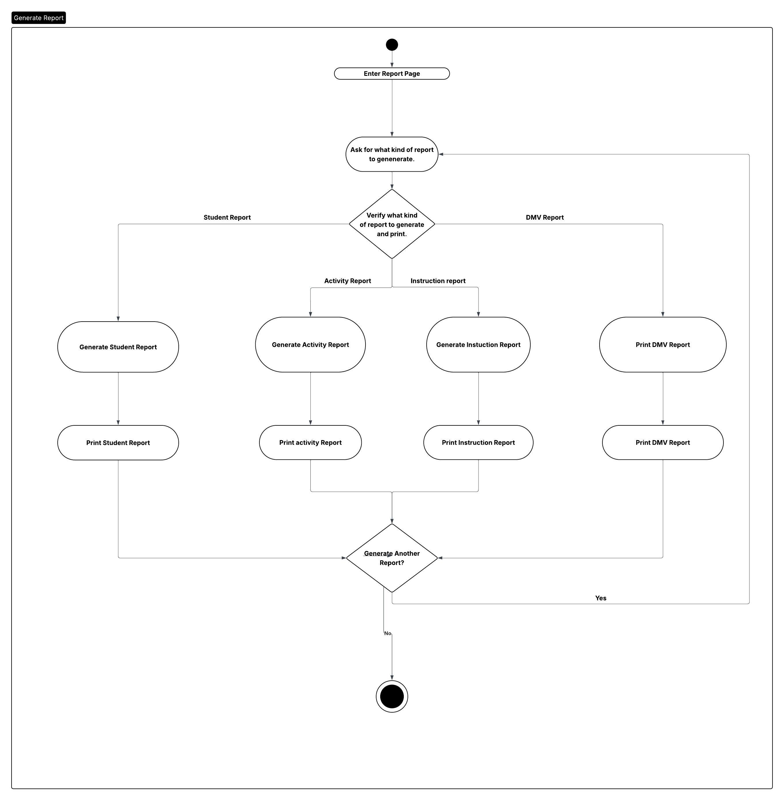
Activity Diagram
Notes:
This diagram walks through what happens when a manager needs to generate a report in DriverPass. The generate report process will allow management to print reports such as Student Progress, General Activity, Instruction Report, DMV Reports. Driverpass will ask the manager what report they would like to generate, right now there are four options, and based on which option the manager chooses, the report will be generated and then printed. Once the report has been printed then DriverPass will prompt the manager if they would like to generate another report. If the answer no then they are exited out of the generate report section. This was designed around the need to access different types of business data. DriverPass is built to help management make day to day business decisions without any technical database deconstruction.

Slide 5
Security
To log in a user needs a valid account and a valid password.
A valid password should be at least 12 characters, have one capital letter, one special character, and at least one number.
All user accounts should also be encouraged to use multifactor authentication.
Some user accounts should be required to use multifactor authentication, specifically admin and IT.
All traffic between the browser and the server should be HTTPS secured.
If someone fails to log into an account 5 times, then the account should be locked for review by management or IT.
If a user needs to reset their password, they should be able to reset it themselves through an email link and a phone text validation.
User accounts need a valid phone number.
User accounts need a valid email.
Any activity in the system needs to be logged into DataLog.
Notes:
Security is a major part of DriverPass. DriverPass handles personal information for students, instreuctors, staff, and general business information. There are several layers of protection put into the DriverPass system to help DriverPass be a secure, and safe system for everyone to use. To log in, every user needs a valid account and a valid password. Passwords must be at least 12 characters long and must include at least one capital letter, one special character, and at least one number. This makes sure that passwords are strong enough to protect against someone trying to guess their way in. All users are encouraged to set up multifactor authentication, which means they would need a second form of verification beyond just their password to log in. For IT and management accounts, multifactor authentication is not optional, it is required. All communication between the user's browser and the DriverPass server is secured using HTTPS encryption. This means that any data being sent back and forth is protected and cannot be read by someone intercepting the connection. If someone enters the wrong password five times in a row, the account is automatically locked. A member of management or IT must review the account before it can be unlocked. This prevents someone from repeatedly guessing passwords to break into an account. If a user forgets their password, they do not need to contact anyone to get it fixed. They can reset it themselves through a secure process that requires both an email link and a phone text verification. This is why every account requires a valid email address and a valid phone number. In DriverPass, every action taken in the system is logged. Every login, every password change, every schedule edit, and every report that gets generated is recorded. This gives management and IT a complete record of everything that happens in the system. This is important for both security and accountability.

Slide 6
System Limitations
Offline is limited to read-only information until the offline version allows for offline verification.
Any change in how the system works or looks will need to be changed through development or a developer. DriverPass will own their source code though.
The system is dependent on the DMV providing updates, if they don’t update any of their information then the information in the DriverPass system will be outdated.
Older browser and older operating systems will not be supported.
If the network the user is using is slow DriverPass will also be slow.
Depending on the User available memory DriverPass might run slow.
Notes:
DriverPass does have limitations and they are important to know. First of all, there is limited offline access. While you can use DriverPass offline, you can not change schedules or information that is on DriverPass. Full functionality will always require connection to the server. Any development and changes in how DriverPass works will have to be changed from the Developer. The system is not something easy to change even if you have the source code. Another limitation is whether the DMV updates their rules automatically, if not then the IT staff will have to update the DMV’s rules and regulations themselves. This is good job security though. Another thing to keep in mind is that DriverPass will be made for modern systems. If anyone is using an old computer or phone, then they might not be able to access and use DriverPass. The last thing to keep in mind is that DriverPass’s performance will be based on the user’s own computer or phone. IF someone is on a slow internet connection or has a phone that doesn’t have enough memory or a computer that is from 1983 then they will not get good performance out of DriverPass. These this are out of our control, and they should be stuff that we are aware of so that we can build a system that may minimize those limitations.

